Slide 1
Foundations of Software Engineering
605.601
Impact of Project Characteristics on the Choice of Development Approach
&
Trends in Modern Project Delivery
Johns Hopkins University
Whiting School of Engineering
Engineering for Professionals
Joseph M. Demasco
2022
Notes:
In this course module we discussed a number of different life cycle models that are used in software development. This document contains some industry statistics on life cycle models used in modern software development and how various project characteristics influence the choice of project life cycle in organizations.

Slide 2
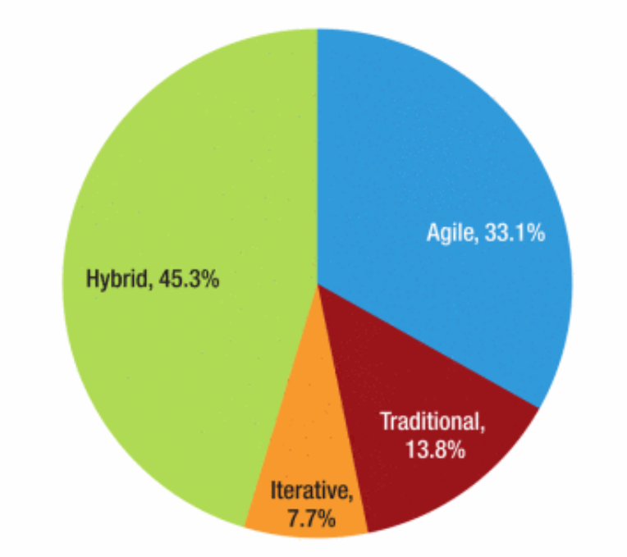
Summary of Development Approaches
Survey of 153 respondents from many different business sectors
133 U.S. respondents
39% new projects
24% enhancements
13% COTS
10% system integration
7% migration
7% other
Vijayasarathy, L.R., Butler, C.W., Choice of Software Development Methodologies: Do Organizational, Project, and Team Characteristics Matter?, IEEE Software, Volume 33, Issue 5, Sep-Oct 2016
Notes:
We’re going to start by looking at the results of a study that investigated how various organizational, project, and team characteristics influenced the choice of software development approaches.
As you can see from the slide, there were 153 respondents to the referenced survey with most respondents from the United States, and there were various types of projects that the respondent organizations were involved in.
The most common life cycle approach reported by the respondents was a hybrid approach…which translates into a combination of a waterfall approach and more modern iterative or agile-like approaches.

Slide 3
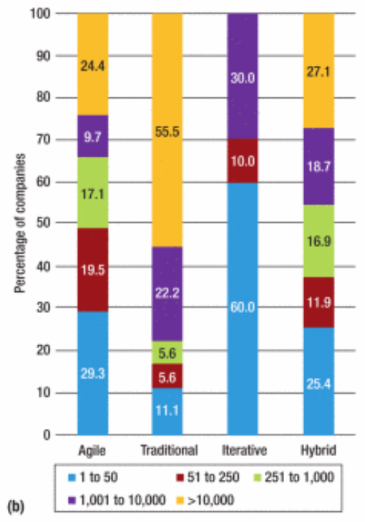
Approach Based on Number of Employees
Companies with high employee counts were the dominant group for traditional approaches
Companies with low employee counts were the dominant group for iterative and agile approaches
Vijayasarathy, L.R., Butler, C.W., Choice of Software Development Methodologies: Do Organizational, Project, and Team Characteristics Matter?, IEEE Software, Volume 33, Issue 5, Sep-Oct 2016
Notes:
This chart summarizes the results based upon the number of employees in respondent companies…and there are some interesting patterns here.
If you look at the larger companies:
55 % of companies that used traditional approaches had more than 10,000 employees.
77.7 % of companies that used traditional approaches had more than 1,000 employees.
45.8 % of companies that used hybrid approaches had more than 1,000 employees.
34.1 % of companies that used agile approaches had more than 1,000 employees.
30 % of companies that used iterative approaches had more than 1,000 employees.
If you look at the smaller companies…say those with up to 250 employees:
70 % of companies used iterative approaches.
48.8 % of companies used agile approaches.
37.3 % of companies used hybrid approaches.
16.7 % of companies used traditional approaches.
So…in summary…companies with high employee counts were the dominant group for the more traditional approaches, and companies with low employee counts were the dominant group for iterative and agile approaches.

Slide 4
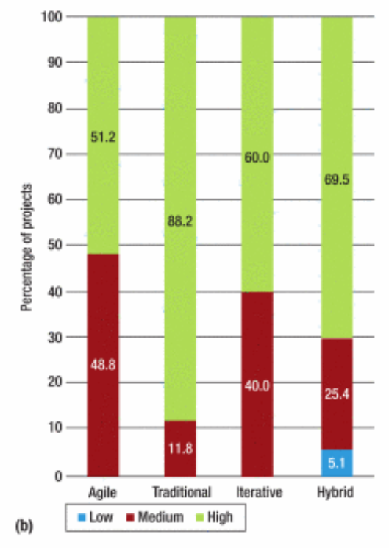
Approaches Based on Project Criticality
Organizations tend to use traditional approaches on high criticality projects…followed by hybrid, iterative, and agile approaches
Vijayasarathy, L.R., Butler, C.W., Choice of Software Development Methodologies: Do Organizational, Project, and Team Characteristics Matter?, IEEE Software, Volume 33, Issue 5, Sep-Oct 2016
Notes:
This chart shows the approaches based upon project criticality.
88.2 % of projects using traditional approaches had high criticality.
69.5 % of projects using hybrid approaches had high criticality.
60 % of projects using iterative approaches had high criticality.
51.2 % of projects using agile approaches had high criticality.
This data suggests that organizations tend to use traditional approaches on critical projects, followed by hybrid and iterative then agile approaches.

Slide 5
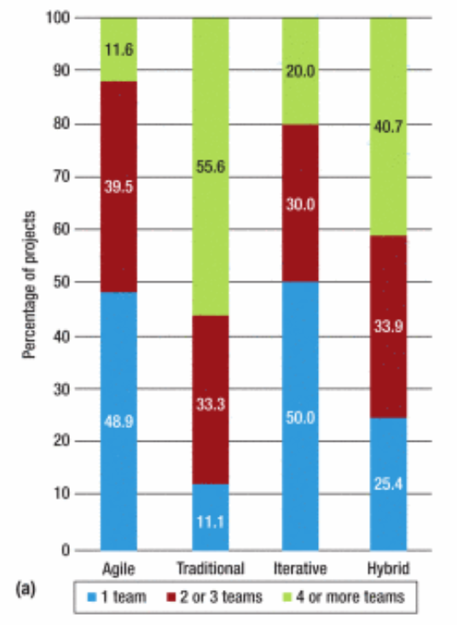
Approaches Based on Project Teams
Projects with 1 team were the most prevalent for agile and iterative approaches
Projects with 2-3 teams were distributed fairly equally across all approaches
Projects with 4 or more teams were the most prevalent with traditional and hybrid approaches
Vijayasarathy, L.R., Butler, C.W., Choice of Software Development Methodologies: Do Organizational, Project, and Team Characteristics Matter?, IEEE Software, Volume 33, Issue 5, Sep-Oct 2016
Notes:
This chart summarizes responses based on the number of project teams that were used.

Slide 6
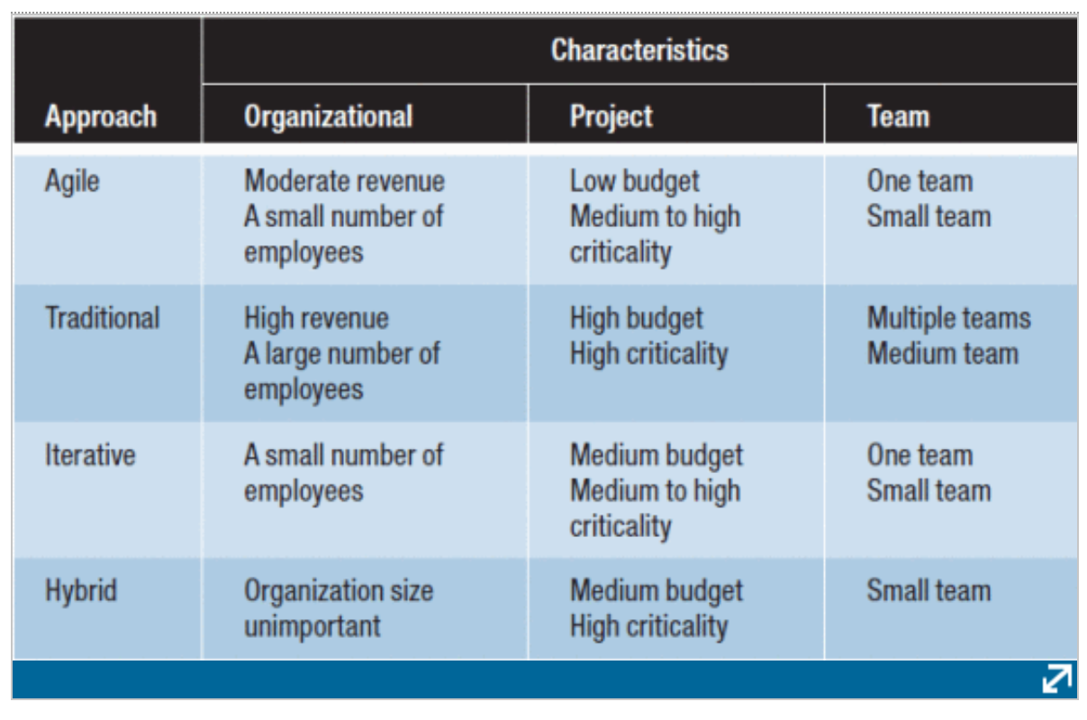
Project Characteristics and Approaches
Vijayasarathy, L.R., Butler, C.W., Choice of Software Development Methodologies: Do Organizational, Project, and Team Characteristics Matter?, IEEE Software, Volume 33, Issue 5, Sep-Oct 2016
Notes:
This table summarizes the characteristics of projects and the approaches that were reported. The characteristics are based on organizational, project budget and criticality, and team factors that had strong statistical significance with the development approaches in the survey. The table offers some insights into how some project characteristics might influence the choice of a development approach.

Slide 7
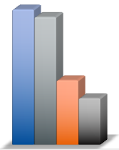
Trends in Modern Project Delivery
61.1 %
57.7 %
29.1 %
21 %
Trends in Modern Project Delivery, Project Management Institute & Wrike Inc., 2021
Notes:
This slide summarizes a recent study performed by the Project Management Institute (PMI) and Wrike, Inc. a company that provides project management application services. The slide shows the answers to the following question: “Which of the following approaches to project delivery are used in your organization?”
61.1 percent of respondents indicated that they used hybrid approaches. In this study hybrid was defined as some mix of traditional and agile.
57.7 percent of respondents indicated that they used traditional waterfall approaches.
29.1 percent of respondents indicated that they used agile.
And 21 percent of responded that they used ad hoc approaches.
Note that the percentages total to more than 100 percent due to multiple selections being allowed.
An additional statistic not evident from these numbers is interesting: 23.3 percent of respondents said they used hybrid as the only delivery approach
And for respondents in the information technology business:
70.5 percent indicated using hybrid approaches in some form
48.4 percent indicated using agile in some form

